Slide 1
A brief user guide to the 2022 Robocon scoreboard

Slide 2
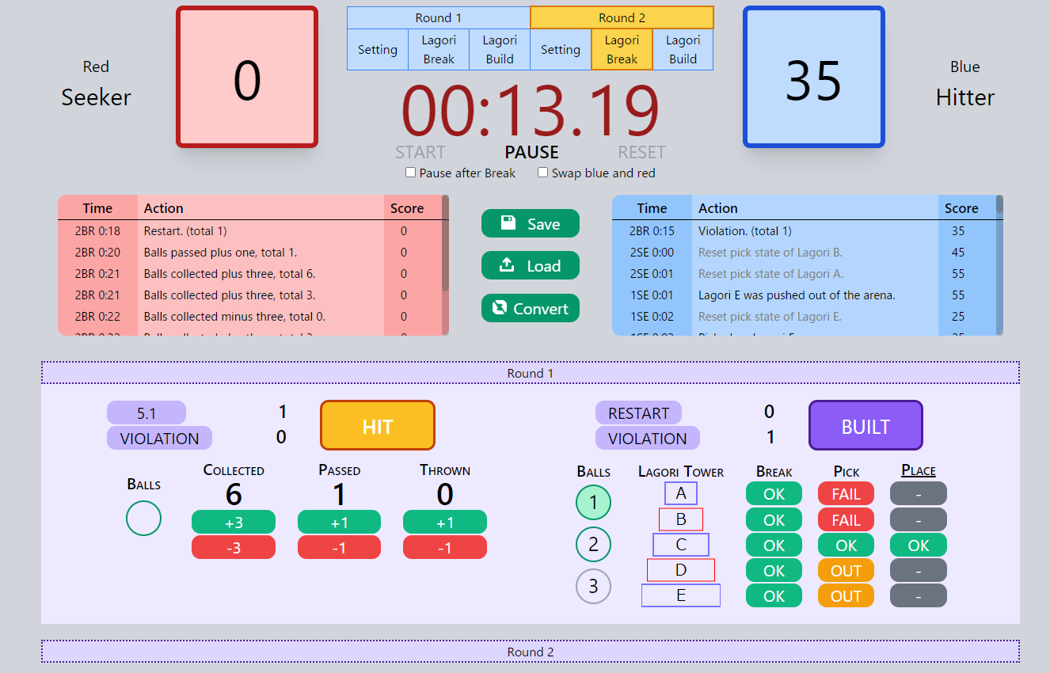
Pause after Break: whether to pause the timer after the Lagori tower is broken
Swap blue and red: swaps the scoreboards
Timer and Game State Indicator
(clicking the states will set the timer to 5 seconds)
During Breakshot:
When the R1 shoots a ball and only when hits the lagori tower, click the 1st ball
Then, select the Lagoris broken by the first ball, and so on
The Breakshot time will automatically end after any 1 of the 3 conditions are met
Restart
click → start restart timer
click again → stop restart timer
(restarts will be automatically ended at the end of a round)
Violation: counts the number of violations
Right click to cancel/delete a restart / violation
Score, Role and Team Color
Eventboard
During Building:
After breaking certain Lagoris, the Pick and Place buttons will be enabled
Left click Pick when R2 picks up a Lagori
Right click Pick if a Lagori rolls out of the arena
Left click Place when the Lagori is placed on the tower
Built automatically lights up when all 5 Lagoris are stacked and the round will end
Click HIT when Hitter R1 shoots the BOH off, the round will end automatically
Collected: click when the robot arrives at the ball rack
Passed: click when the ball arrives at R1, don’t click if it misses the net
Thrown: balls thrown at Seeker R2
Feature:
Click and Drag to select the Lagoris quicker

Slide 3
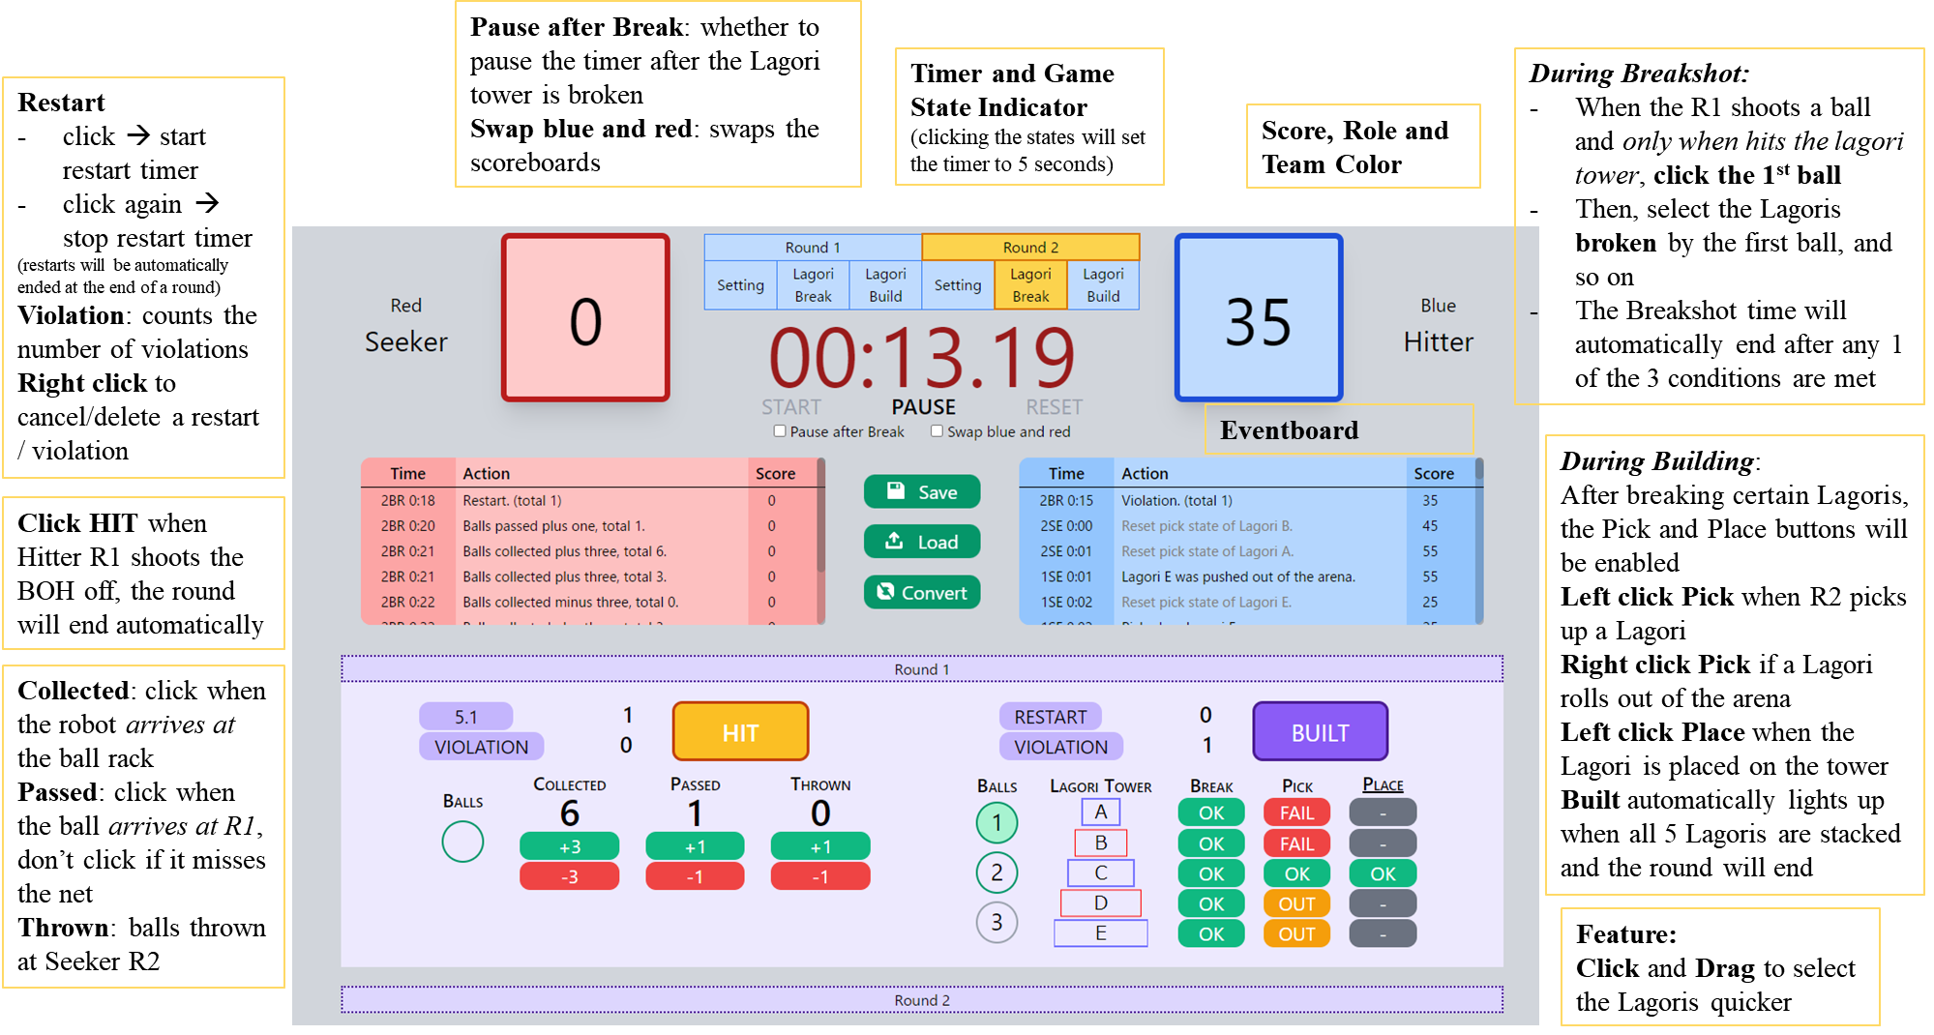

Slide 4
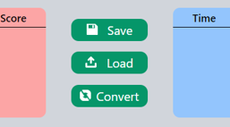
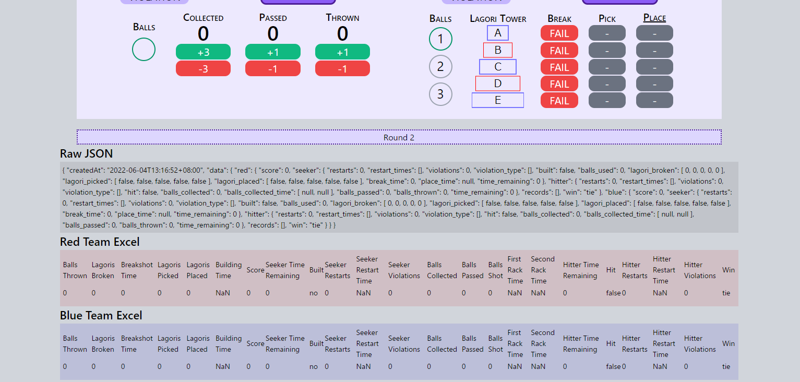
Save: downloads a JSON file containing the game data and records
Load: doesn’t work
Convert: generates the following fields at the bottom of the page
The “Excel” fields are tables that can be directly copied and pasted into an Excel file for recording

Slide 5
